Slide 1










AUTOMATIC HAND WASHING SYSTEM

Slide 2
PROBLEM STATEMENT
Conventional hand washing methods often require physical contact, which increases the risk of spreading infections and reduces overall hygiene efficiency.

Slide 3
SOLUTION
We developed an Arduino-based automatic hand wash system that dispenses soap and water automatically and includes a touch-free dryer, providing a fast, safe, and hygienic handwashing experience.

Slide 4
INTRODUCTION
Hand hygiene is one of the most effective ways to prevent the spread of infections.
Traditional methods often involve physical contact, increasing health risks.
The demand for touch-free, cost-effective, and reliable handwashing systems has grown significantly, especially after the COVID-19 pandemic.
Our project integrates automatic soap dispensing, water flow, and drying into a single contactless system for improved hygiene and convenience.

Slide 5
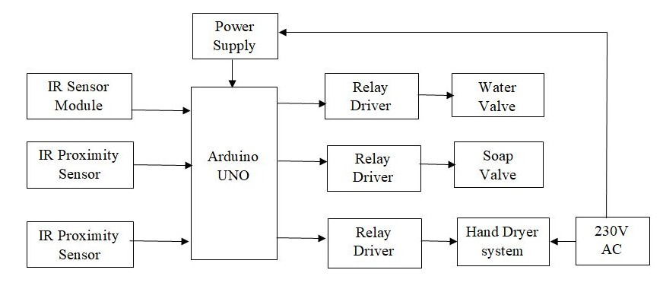
BLOCK DIAGRAM

Slide 6
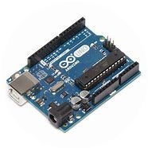
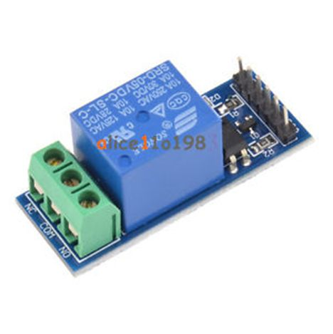
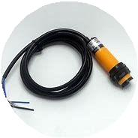
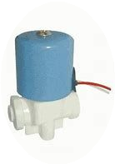
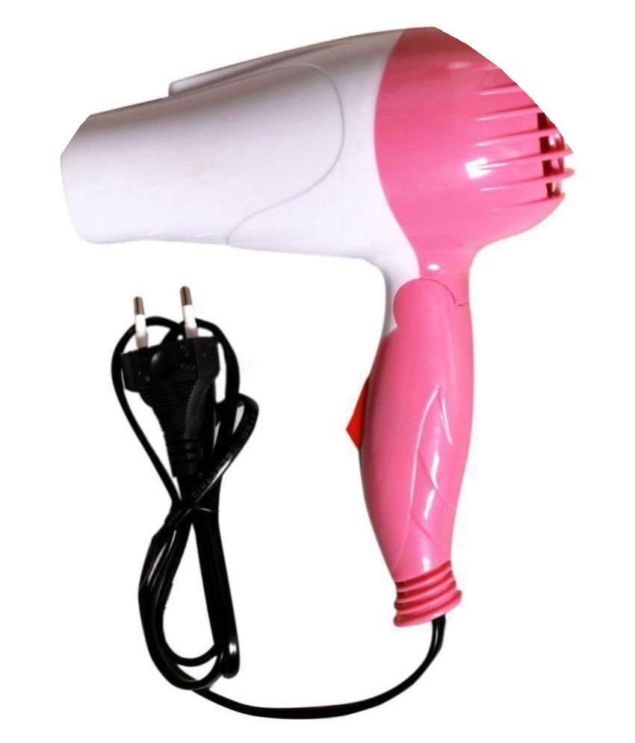
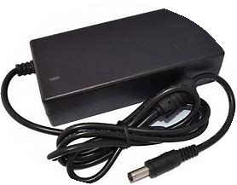
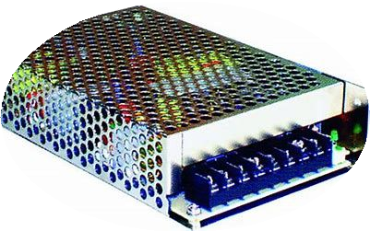
COMPONENTS LIST
Arduino UNO R3
Relay Modules - 3
IR Proximity sensors (E18-D80NK) -3 Solenoid Valves - 2
Hand dryer 24 V DC Adopter
Voltage regulated power supply

Slide 7
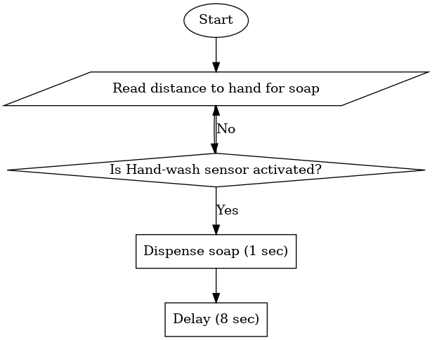
FLOWCHART OF CODE
Soap dispenser Section:

Slide 8
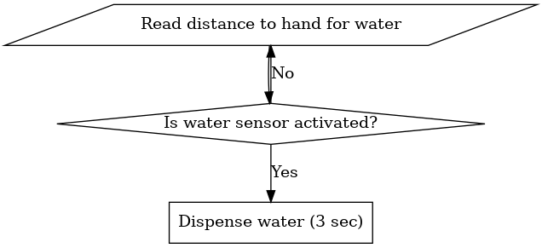
FLOWCHART OF CODE
2) Water dispenser Section:

Slide 9
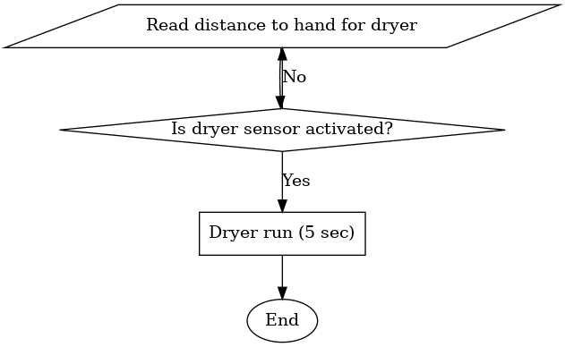
FLOWCHART OF CODE
2) Dryer Section:

Slide 10
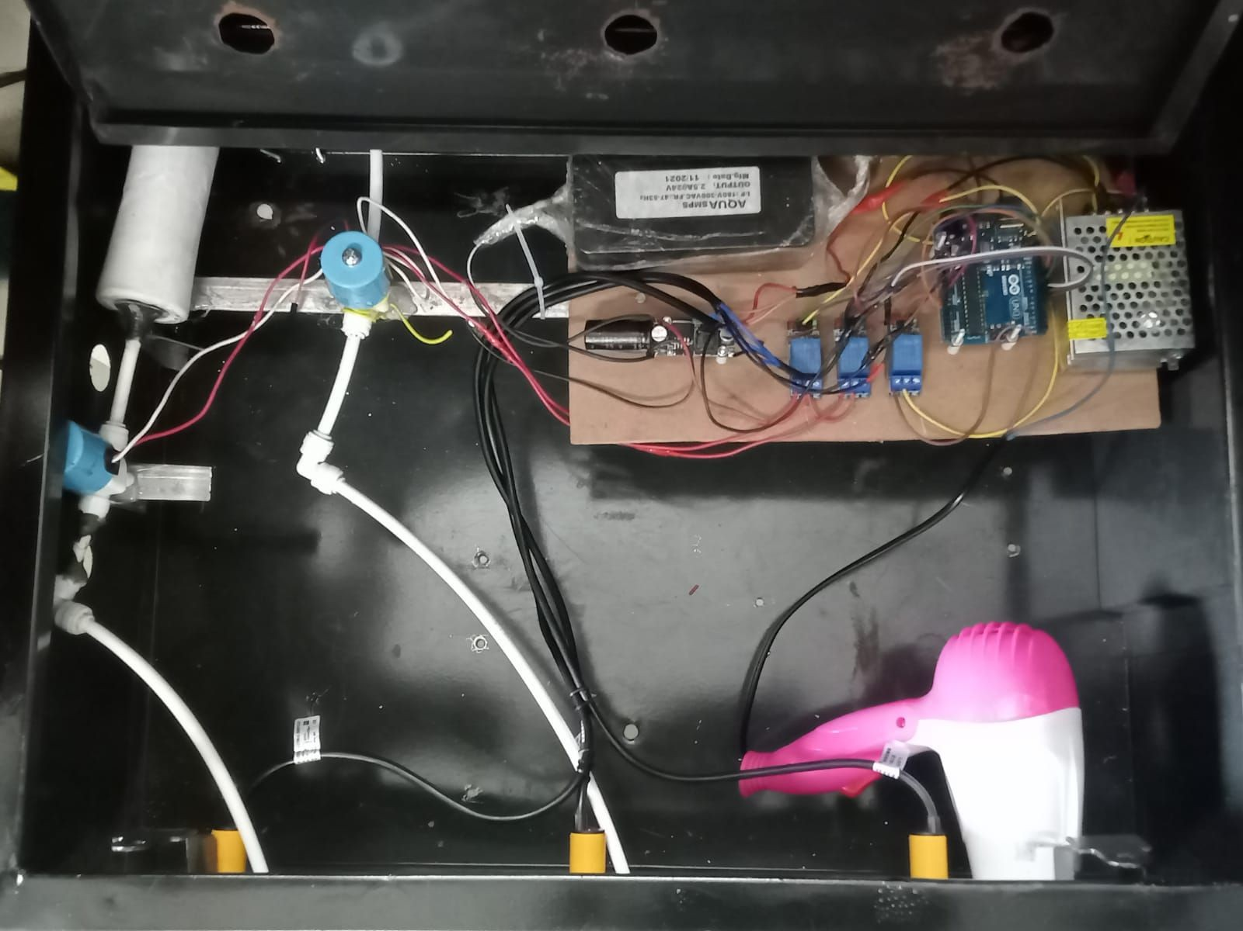
ACTUAL HARDWARE

Slide 11
Thank you

